Slide 1

Section 3.1 Derivative of Polynomials and Exponential Functions
Lecture 2
Limit laws reach to derivatives

Slide 2
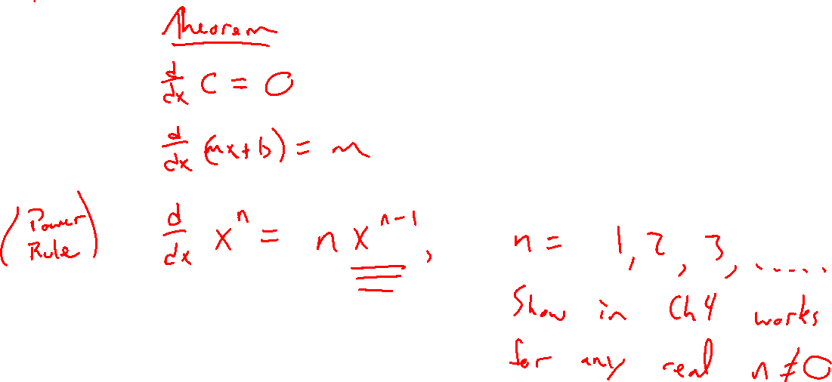
Recap:
Notes:
Power rule, constants, and lines.
Remind of quadratic example separating into three powers.

Slide 3
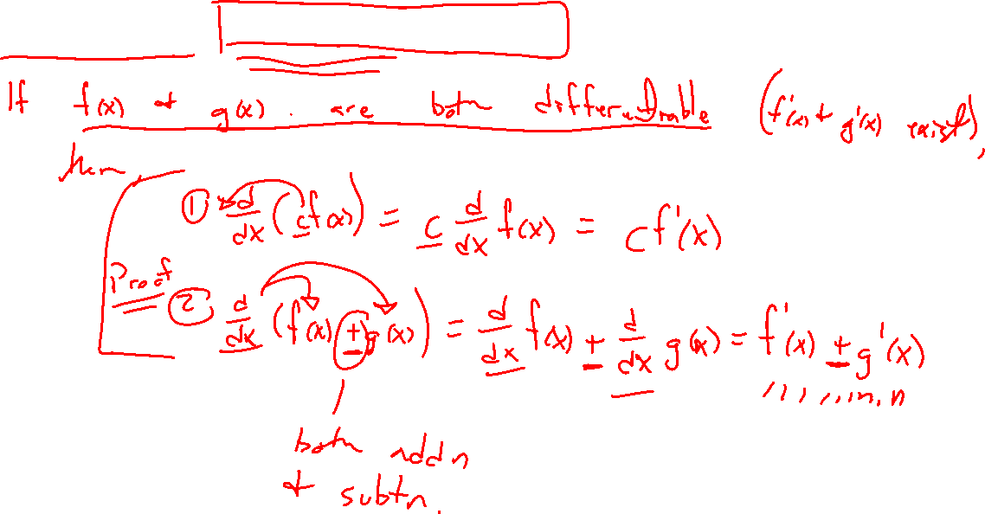
Theorems: Limit Laws Again
Notes:
D/dx (cf(x)) = cf'(x)
D/dx (f(x) +- g(x)) = f'(x)+g'(x)
Can treat d/dx as a operator (like limits or multiplication in a way)

Slide 4
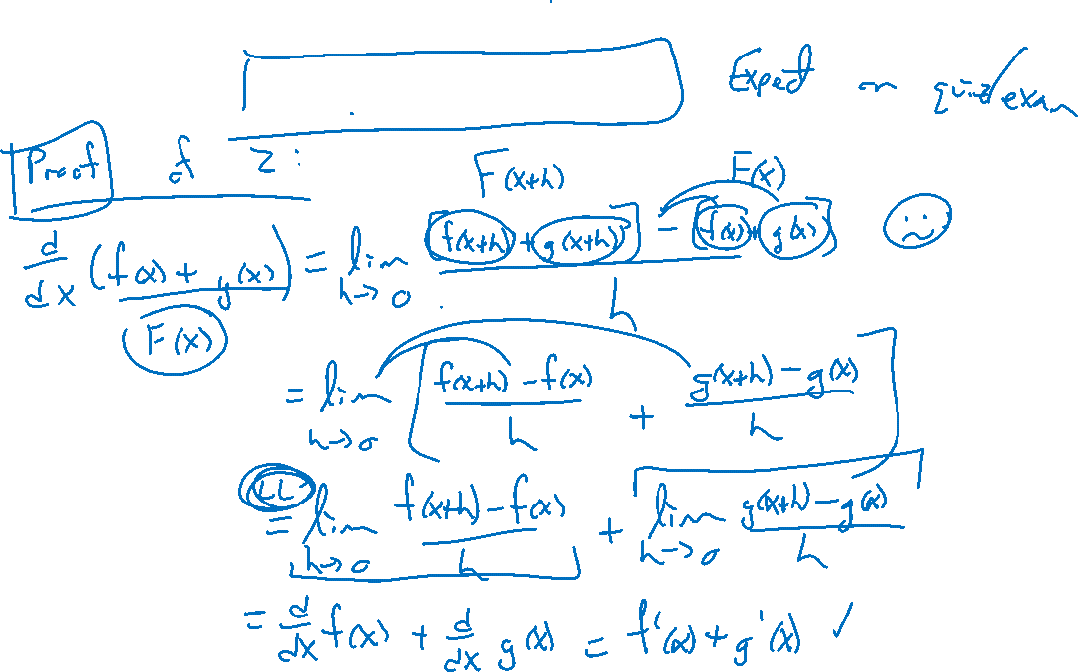
Theorems: Limit Laws Again
Notes:
Proof of sum diff rule

Slide 5
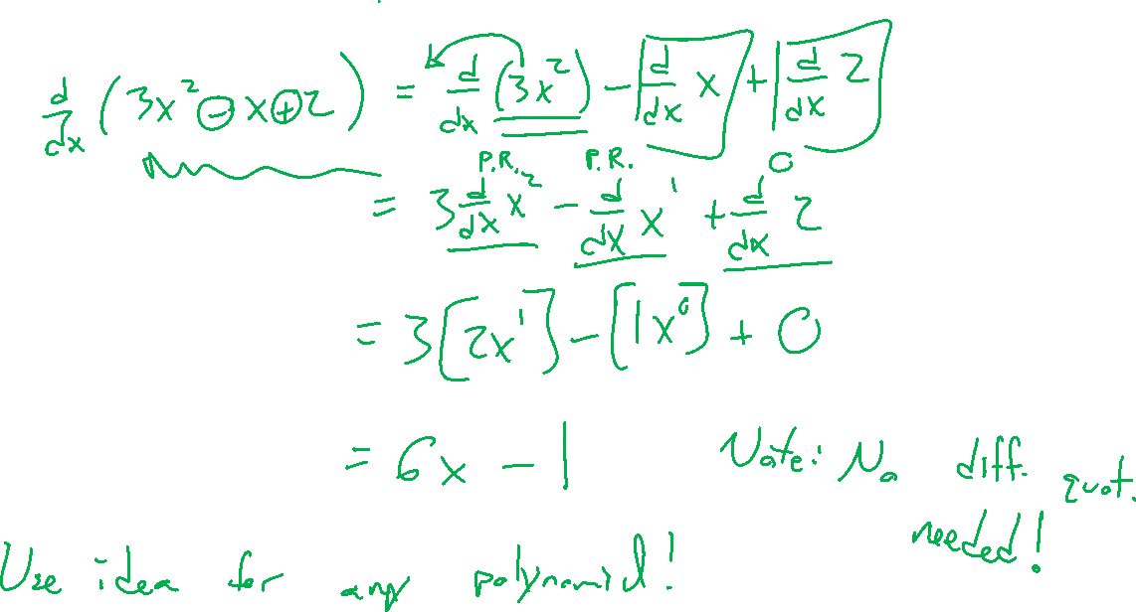
Example:
Notes:
Apply theorem to previous example: random quadratic
Can see how rules are key to avoiding diff quotient

Slide 6
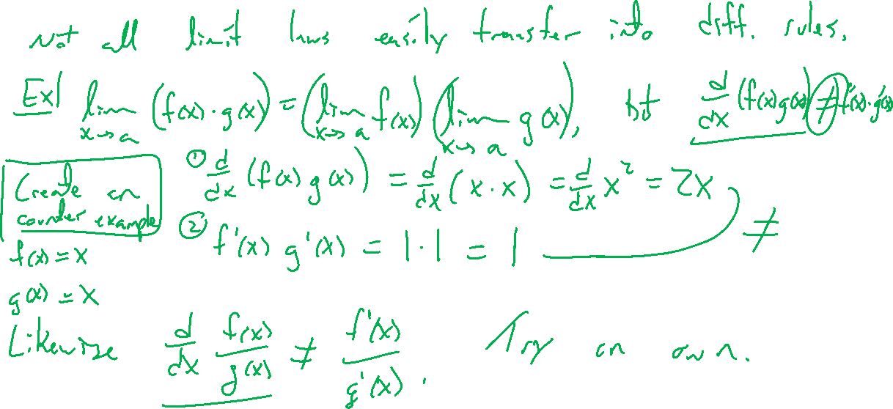
Warning: Limits of Limit Laws
Notes:
Note, no simple diff rule for prod, quot
(f g)' \neq f' g'
(f / g)' \neq f'/g'
Try on own: Create random examples to show not same.

Slide 7
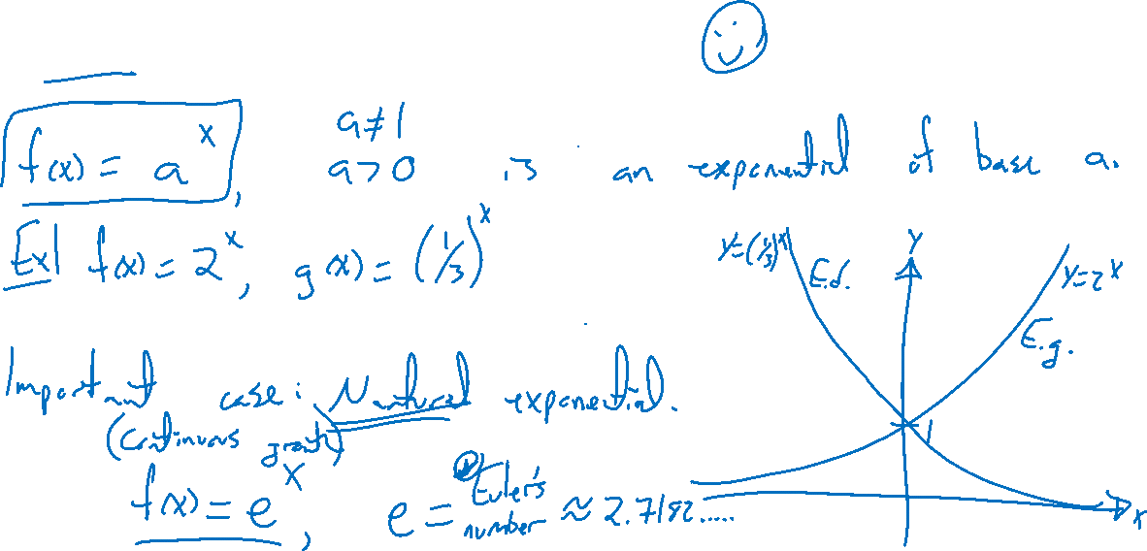
Recap: Exponential functions
Notes:
A^x, different a
E^x importance, compound interest desmos
Search eulers number, more important than pi?

Slide 8
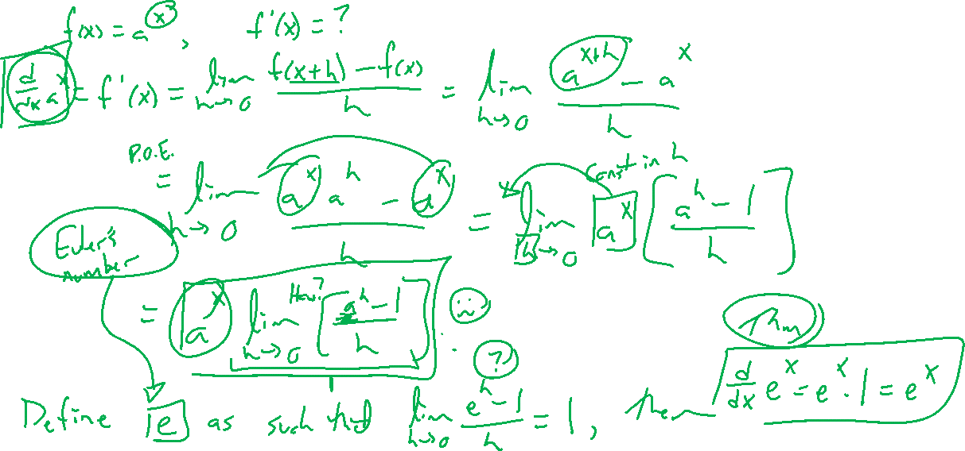
Derivative of Exponential Functions
Notes:
Difference quotient for general a^x
Definition: F'(0) limit is 1 for e.
Desmos graph.
Will have to wait for other exponentials
Note can diff e^x many times, unchanged.

Slide 9

Section 3.1: Textbook Examples and Exercises
Rework examples 1, 2, 3, 6, 9 in the text. Steps:
Write down a problem.
Close the book and attempt on own.
Check / correct your solution against the text solution.
If needed, rewrite the problem to be of the quality of the text solution.
Complete exercises 23, 27, 35, 49, 55
Write solutions of the same quality as in lecture and text solutions.
Check your solution against the answer in the back of the book.
Video reflection
https://www.youtube.com/watch?v=S0_qX4VJhMQ&list=PLZHQObOWTQDMsr9K-rj53DwVRMYO3t5Yr&index=3

Slide 10




Homework Submission to Canvas
Preview of section
Skim the section in text and write a short paragraph summary.
Give a bulleted list of all important definitions, theorems, and formulas without details.
Notes on video lectures
Take notes on everything written on slides including all details, worked examples, on-own activities, as well as your own thoughts and questions.
Try on-own activities first, then write down provided solution next to it for comparison.
Worked examples from the text
Write down the problem and attempt without looking at the solution.
Use the solution to write the best explanation you can.
Solutions to textbook exercises
Model approaches and explanations given in the video lectures and textbook examples.
Final reflection of section
List the key takeaways to remember as a bulleted list.
Video reflection (for some sections)
Write a 1 paragraph reflection on the video discussing what you found most interesting or useful.

